Slide 1
Dense Matrix Algorithms
Ananth Grama, Anshul Gupta,
George Karypis, and Vipin Kumar
To accompany the text “Introduction to Parallel Computing”,
Addison Wesley, 2003.

Slide 2
Topic Overview
Matrix-Vector Multiplication
Matrix-Matrix Multiplication
Solving a System of Linear Equations

Slide 3
Matix Algorithms: Introduction
Due to their regular structure, parallel computations involving matrices and vectors readily lend themselves to data-decomposition.
Typical algorithms rely on input, output, or intermediate data decomposition.
Most algorithms use one- and two-dimensional block, cyclic, and block-cyclic partitionings.

Slide 4

Matrix-Vector Multiplication
We aim to multiply a dense n x n matrix A with an n x 1 vector x to yield the n x 1 result vector y.
The serial algorithm requires n² multiplications and additions.

Slide 5
Matrix-Vector Multiplication:
Rowwise 1-D Partitioning
The n x n matrix is partitioned among n processors, with each processor storing complete row of the matrix.
The n x 1 vector x is distributed such that each process owns one of its elements.

Slide 6
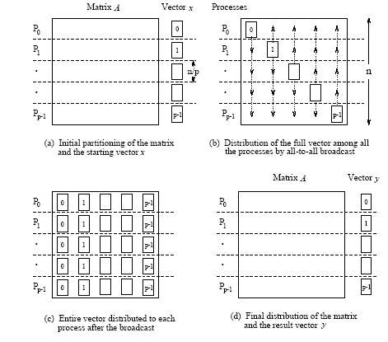
Matrix-Vector Multiplication:
Rowwise 1-D Partitioning
Multiplication of an n x n matrix with an n x 1 vector using
rowwise block 1-D partitioning. For the one-row-per-process
case, p = n.

Slide 7

Matrix-Vector Multiplication:
Rowwise 1-D Partitioning
Since each process starts with only one element of x , an all-to-all broadcast is required to distribute all the elements to all the processes.
Process P_{i} now computes .
The all-to-all broadcast and the computation of y[i] both take time Θ(n) . Therefore, the parallel time is Θ(n) .

Slide 8
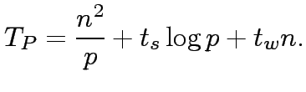
Matrix-Vector Multiplication:
Rowwise 1-D Partitioning
Consider now the case when p < n and we use block 1D partitioning.
Each process initially stores n=p complete rows of the matrix and a portion of the vector of size n=p.
The all-to-all broadcast takes place among p processes and involves messages of size n=p.
This is followed by n=p local dot products.
Thus, the parallel run time of this procedure is
This is cost-optimal.

Slide 9

Matrix-Vector Multiplication:
Rowwise 1-D Partitioning
Scalability Analysis:
We know that T₀ = pT_{P} - W, therefore, we have,
For isoefficiency, we have W = KT₀, where K = E/(1 – E) for desired efficiency E.
From this, we have W = O(p²) (from the t_{w} term).
There is also a bound on isoefficiency because of concurrency. In this case, p < n, therefore, W = n² = Ω(p²).
Overall isoefficiency is W = O(p²).

Slide 10
Matrix-Vector Multiplication:
2-D Partitioning
The n x n matrix is partitioned among n² processors such that each processor owns a single element.
The n x 1 vector x is distributed only in the last column of n processors.

Slide 11
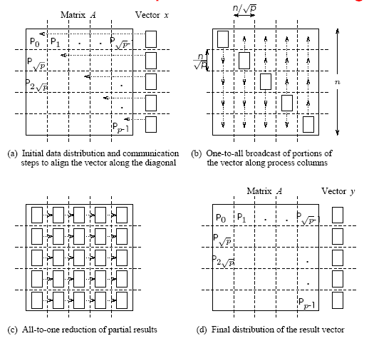
Matrix-Vector Multiplication: 2-D Partitioning
Matrix-vector multiplication with block 2-D partitioning. For the
one-element-per-process case, p = n² if the matrix size is n x n .

Slide 12
Matrix-Vector Multiplication:
2-D Partitioning
We must first align the vector with the matrix appropriately.
The first communication step for the 2-D partitioning aligns the vector x along the principal diagonal of the matrix.
The second step copies the vector elements from each diagonal process to all the processes in the corresponding column using n simultaneous broadcasts among all processors in the column.
Finally, the result vector is computed by performing an all-to-one reduction along the columns.

Slide 13
Matrix-Vector Multiplication:
2-D Partitioning
Three basic communication operations are used in this algorithm: one-to-one communication to align the vector along the main diagonal, one-to-all broadcast of each vector element among the n processes of each column, and all-to-one reduction in each row.
Each of these operations takes Θ(log n) time and the parallel time is Θ(log n) .
The cost (process-time product) is Θ(n² log n) ; hence, the algorithm is not cost-optimal.

Slide 14


Matrix-Vector Multiplication:
2-D Partitioning
When using fewer than n² processors, each process owns an block of the matrix.
The vector is distributed in portions of elements in the last process-column only.
In this case, the message sizes for the alignment, broadcast, and reduction are all .
The computation is a product of an submatrix with a vector of length .

Slide 15



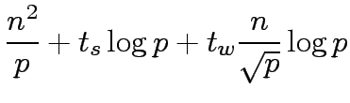


Matrix-Vector Multiplication:
2-D Partitioning
The first alignment step takes time
The broadcast and reductions take time
Local matrix-vector products take time
Total time is

Slide 16





Matrix-Vector Multiplication:
2-D Partitioning
Scalability Analysis:
Equating T₀ with W, term by term, for isoefficiency, we have, as the dominant term.
The isoefficiency due to concurrency is O(p).
The overall isoefficiency is (due to the network bandwidth).
For cost optimality, we have, . For this, we have,

Slide 17
Matrix-Matrix Multiplication
Consider the problem of multiplying two n x n dense, square matrices A and B to yield the product matrix C =A x B.
The serial complexity is O(n³).
We do not consider better serial algorithms (Strassen's method), although, these can be used as serial kernels in the parallel algorithms.
A useful concept in this case is called block operations. In this view, an n x n matrix A can be regarded as a q x q array of blocks A_{i,j} (0 ≤ i, j < q) such that each block is an (n/q) x (n/q) submatrix.
In this view, we perform q³ matrix multiplications, each involving (n/q) x (n/q) matrices.

Slide 18

Matrix-Matrix Multiplication
Consider two n x n matrices A and B partitioned into p blocks A_{i,j} and B_{i,j} (0 ≤ i, j < ) of size each.
Process P_{i,j} initially stores A_{i,j} and B_{i,j} and computes block C_{i,j} of the result matrix.
Computing submatrix C_{i,j} requires all submatrices A_{i,k} and B_{k,j} for 0 ≤ k < .
All-to-all broadcast blocks of A along rows and B along columns.
Perform local submatrix multiplication.

Slide 19

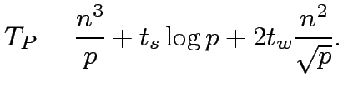
Matrix-Matrix Multiplication
The two broadcasts take time
The computation requires multiplications of sized submatrices.
The parallel run time is approximately
The algorithm is cost optimal and the isoefficiency is O(p^{1.5}) due to bandwidth term t_{w} and concurrency.
Major drawback of the algorithm is that it is not memory optimal.

Slide 20
Matrix-Matrix Multiplication:
Cannon's Algorithm
In this algorithm, we schedule the computations of the processes of the ith row such that, at any given time, each process is using a different block A_{i,k}.
These blocks can be systematically rotated among the processes after every submatrix multiplication so that every process gets a fresh A_{i,k} after each rotation.

Slide 21
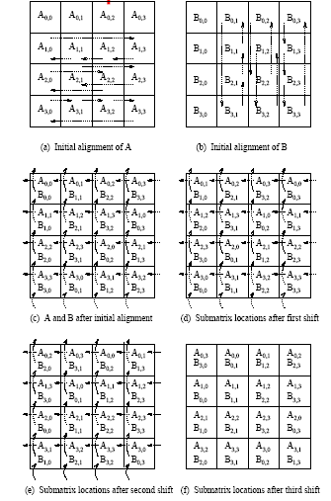
Matrix-Matrix Multiplication:
Cannon's Algorithm
Communication steps in Cannon's algorithm on 16 processes.

Slide 22
Matrix-Matrix Multiplication:
Cannon's Algorithm
Align the blocks of A and B in such a way that each process multiplies its local submatrices. This is done by shifting all submatrices A_{i,j} to the left (with wraparound) by i steps and all submatrices B_{i,j} up (with wraparound) by j steps.
Perform local block multiplication.
Each block of A moves one step left and each block of B moves one step up (again with wraparound).
Perform next block multiplication, add to partial result, repeat until all blocks have been multiplied.

Slide 23




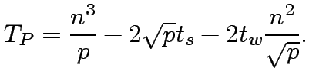
Matrix-Matrix Multiplication:
Cannon's Algorithm
In the alignment step, since the maximum distance over which a block shifts is , the two shift operations require a total of time.
Each of the single-step shifts in the compute-and-shift phase of the algorithm takes time.
The computation time for multiplying matrices of size is .
The parallel time is approximately:
The cost-efficiency and isoefficiency of the algorithm are identical to the first algorithm, except, this is memory optimal.

Slide 24
Matrix-Matrix Multiplication:
DNS Algorithm
Uses a 3-D partitioning.
Visualize the matrix multiplication algorithm as a cube . matrices A and B come in two orthogonal faces and result C comes out the other orthogonal face.
Each internal node in the cube represents a single add-multiply operation (and thus the complexity).
DNS algorithm partitions this cube using a 3-D block scheme.

Slide 25
Matrix-Matrix Multiplication:
DNS Algorithm
Assume an n x n x n mesh of processors.
Move the columns of A and rows of B and perform broadcast.
Each processor computes a single add-multiply.
This is followed by an accumulation along the C dimension.
Since each add-multiply takes constant time and accumulation and broadcast takes log n time, the total runtime is log n.
This is not cost optimal. It can be made cost optimal by using n / log n processors along the direction of accumulation.

Slide 26
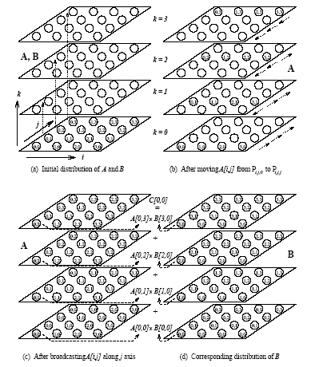
Matrix-Matrix Multiplication:
DNS Algorithm
The communication steps in the DNS algorithm while multiplying 4 x 4 matrices A and B on 64 processes.

Slide 27
Matrix-Matrix Multiplication:
DNS Algorithm
Using fewer than n³ processors.
Assume that the number of processes p is equal to q³ for some q < n.
The two matrices are partitioned into blocks of size (n/q) x(n/q).
Each matrix can thus be regarded as a q x q two-dimensional square array of blocks.
The algorithm follows from the previous one, except, in this case, we operate on blocks rather than on individual elements.

Slide 28





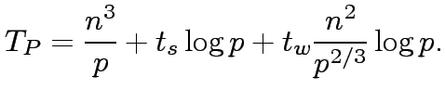

Matrix-Matrix Multiplication:
DNS Algorithm
Using fewer than n³ processors.
The first one-to-one communication step is performed for both A and B, and takes time for each matrix.
The two one-to-all broadcasts take time for each matrix.
The reduction takes time .
Multiplication of submatrices takes time.
The parallel time is approximated by:
The isoefficiency function is .

Slide 29
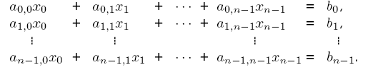
Solving a System of Linear Equations
Consider the problem of solving linear equations of the kind:
This is written as Ax = b, where A is an n x n matrix with A[i, j] = a_{i,j}, b is an n x 1 vector [ b₀, b₁, … , b_{n} ]^{T}, and x is the solution.

Slide 30
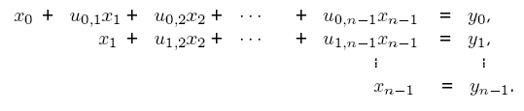
Solving a System of Linear Equations
Two steps in solution are: reduction to triangular form, and back-substitution. The triangular form is as:
We write this as: Ux = y .
A commonly used method for transforming a given matrix into an upper-triangular matrix is Gaussian Elimination.

Slide 31
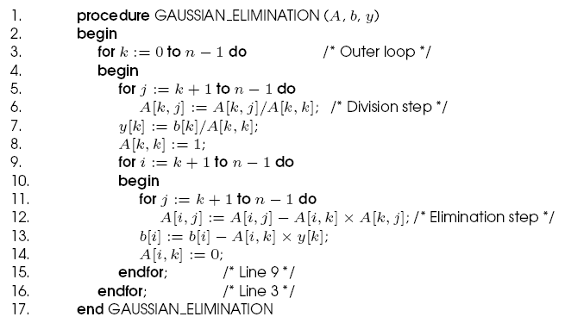
Gaussian Elimination
Serial Gaussian Elimination

Slide 32
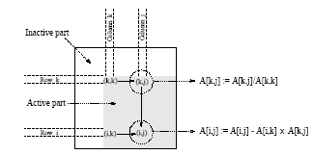
Gaussian Elimination
The computation has three nested loops - in the kth iteration of the outer loop, the algorithm performs (n-k)² computations. Summing from k = 1..n, we have roughly (n³/3) multiplications-subtractions.
A typical computation in Gaussian elimination.

Slide 33


Parallel Gaussian Elimination
Assume p = n with each row assigned to a processor.
The first step of the algorithm normalizes the row. This is a serial operation and takes time (n-k) in the kth iteration.
In the second step, the normalized row is broadcast to all the processors. This takes time .
Each processor can independently eliminate this row from its own. This requires (n-k-1) multiplications and subtractions.
The total parallel time can be computed by summing from k = 1 … n-1 as
The formulation is not cost optimal because of the t_{w} term.

Slide 34
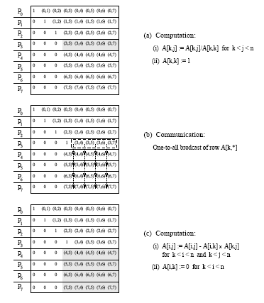
Parallel Gaussian Elimination
Gaussian elimination steps during the iteration corresponding k = 3 for an 8 x 8 matrix partitioned rowwise among eight processes.

Slide 35
Parallel Gaussian Elimination:
Pipelined Execution
In the previous formulation, the (k+1)st iteration starts only after all the computation and communication for the kth iteration is complete.
In the pipelined version, there are three steps - normalization of a row, communication, and elimination. These steps are performed in an asynchronous fashion.
A processor P_{k} waits to receive and eliminate all rows prior to k.
Once it has done this, it forwards its own row to processor Pk+1.

Slide 36
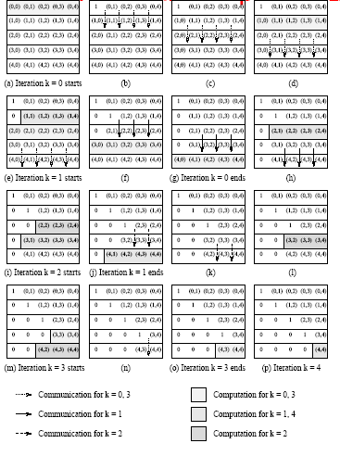
Parallel Gaussian Elimination:
Pipelined Execution
Pipelined Gaussian elimination on a 5 x 5 matrix partitioned withone row per process.

Slide 37
Parallel Gaussian Elimination:
Pipelined Execution
The total number of steps in the entire pipelined procedure is Θ(n).
In any step, either O(n) elements are communicated between directly-connected processes, or a division step is performed on O(n) elements of a row, or an elimination step is performed on O(n) elements of a row.
The parallel time is therefore O(n²) .
This is cost optimal.

Slide 38
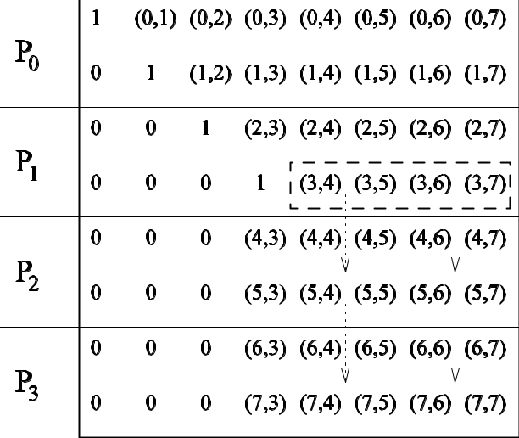
Parallel Gaussian Elimination:
Pipelined Execution
The communication in the Gaussian elimination iteration
corresponding to k = 3 for an 8 x 8 matrix distributed among four processes using block 1-D partitioning.

Slide 39

Parallel Gaussian Elimination:
Block 1D with p < n
The above algorithm can be easily adapted to the case when p < n.
In the kth iteration, a processor with all rows belonging to the active part of the matrix performs (n – k -1) / np multiplications and subtractions.
In the pipelined version, for n > p, computation dominates communication.
The parallel time is given by:
or approximately, n³/p.
While the algorithm is cost optimal, the cost of the parallel algorithm is higher than the sequential run time by a factor of 3/2.

Slide 40
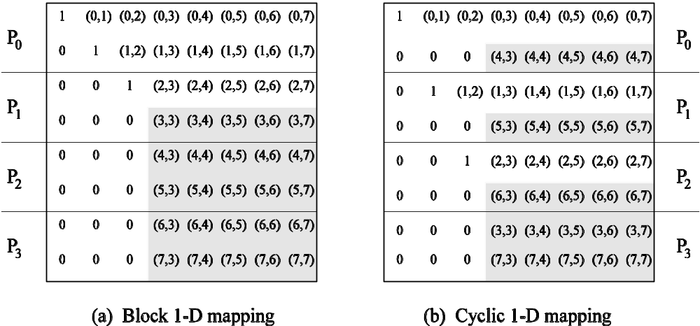
Parallel Gaussian Elimination:
Block 1D with p < n
Computation load on different processes in block and cyclic
1-D partitioning of an 8 x 8 matrix on four processes during the
Gaussian elimination iteration corresponding to k = 3.

Slide 41
Parallel Gaussian Elimination:
Block 1D with p < n
The load imbalance problem can be alleviated by using a cyclic mapping.
In this case, other than processing of the last p rows, there is no load imbalance.
This corresponds to a cumulative load imbalance overhead of O(n²p) (instead of O(n³) in the previous case).

Slide 42
Parallel Gaussian Elimination:
2-D Mapping
Assume an n x n matrix A mapped onto an n x n mesh of processors.
Each update of the partial matrix can be thought of as a scaled rank-one update (scaling by the pivot element).
In the first step, the pivot is broadcast to the row of processors.
In the second step, each processor locally updates its value. For this it needs the corresponding value from the pivot row, and the scaling value from its own row.
This requires two broadcasts, each of which takes log n time.
This results in a non-cost-optimal algorithm.

Slide 43
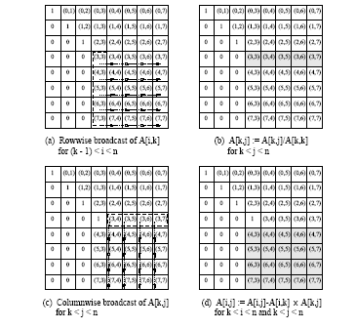
Parallel Gaussian Elimination:
2-D Mapping
Various steps in the Gaussian elimination iteration corresponding to k = 3 for an 8 x 8 matrix on 64 processes arranged in a logical two-dimensional mesh.

Slide 44
Parallel Gaussian Elimination:
2-D Mapping with Pipelining
We pipeline along two dimensions. First, the pivot value is pipelined along the row. Then the scaled pivot row is pipelined down.
Processor P_{i,j} (not on the pivot row) performs the elimination step A[i, j] := A[i, j]] - A[i, k] A[k, j] as soon as A[i, k] and A[k, j] are available.
The computation and communication for each iteration moves through the mesh from top-left to bottom-right as a ``front.''
After the front corresponding to a certain iteration passes through a process, the process is free to perform subsequent iterations.
Multiple fronts that correspond to different iterations are active simultaneously.

Slide 45
Parallel Gaussian Elimination:
2-D Mapping with Pipelining
If each step (division, elimination, or communication) is assumed to take constant time, the front moves a single step in this time. The front takes Θ(n) time to reach P_{n-1,n-1}.
Once the front has progressed past a diagonal processor, the next front can be initiated. In this way, the last front passes the bottom-right corner of the matrix Θ(n) steps after the first one.
The parallel time is therefore O(n) , which is cost-optimal.

Slide 46
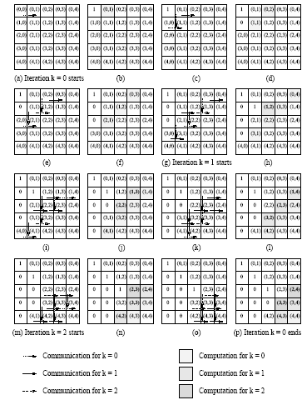
2-D Mapping with Pipelining
Pipelined Gaussian elimination for a 5 x 5 matrix with 25 processors.

Slide 47
Parallel Gaussian Elimination:
2-D Mapping with Pipelining and p < n
In this case, a processor containing a completely active part of the matrix performs n²/p multiplications and subtractions, and communicates words along its row and its column.
The computation dominates communication for n >> p.
The total parallel run time of this algorithm is (2n²/p) x n, since there are n iterations. This is equal to 2n³/p.
This is three times the serial operation count!

Slide 48
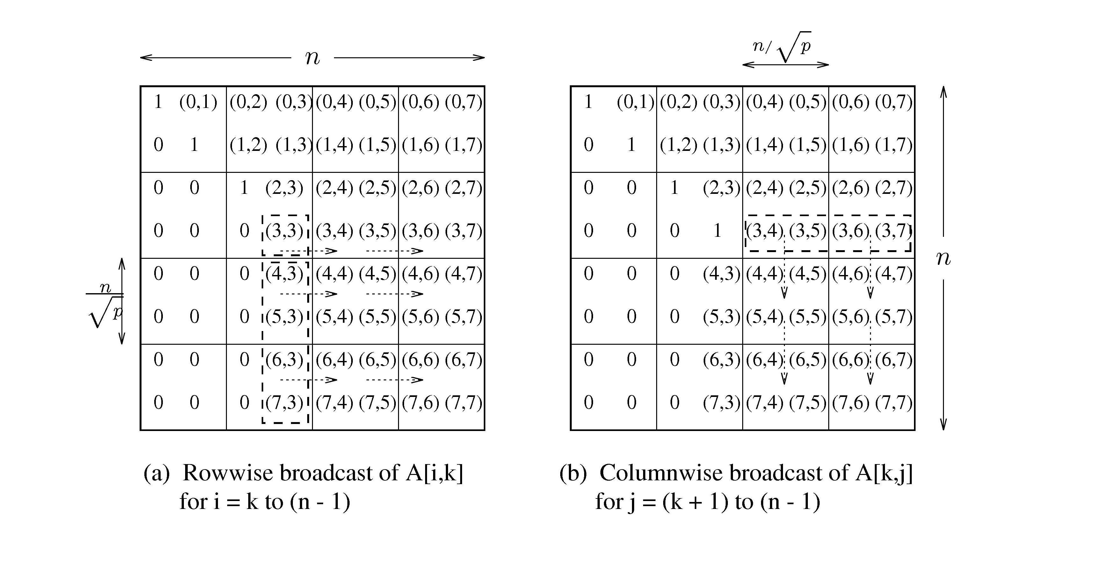
Parallel Gaussian Elimination:
2-D Mapping with Pipelining and p < n
The communication steps in the Gaussian elimination iteration corresponding to k = 3 for an 8 x 8 matrix on 16 processes of a two-dimensional mesh.

Slide 49
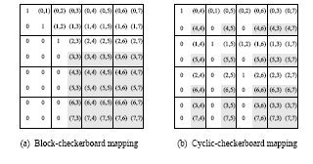
Parallel Gaussian Elimination:
2-D Mapping with Pipelining and p < n
Computational load on different processes in block and cyclic
2-D mappings of an 8 x 8 matrix onto 16 processes during the Gaussian elimination iteration corresponding to k = 3.

Slide 50


Parallel Gaussian Elimination:
2-D Cyclic Mapping
The idling in the block mapping can be alleviated using a cyclic mapping.
The maximum difference in computational load between any two processes in any iteration is that of one row and one column update.
This contributes to the overhead function. Since there are n iterations, the total overhead is .

Slide 51
Gaussian Elimination with Partial Pivoting
For numerical stability, one generally uses partial pivoting.
In the k th iteration, we select a column i (called the pivot column) such that A[k, i] is the largest in magnitude among all A[k, i] such that k ≤ j < n.
The k th and the i th columns are interchanged.
Simple to implement with row-partitioning and does not add overhead since the division step takes the same time as computing the max.
Column-partitioning, however, requires a global reduction, adding a log p term to the overhead.
Pivoting precludes the use of pipelining.

Slide 52
Gaussian Elimination with Partial Pivoting: 2-D Partitioning
Partial pivoting restricts use of pipelining, resulting in performance loss.
This loss can be alleviated by restricting pivoting to specific columns.
Alternately, we can use faster algorithms for broadcast.

Slide 53
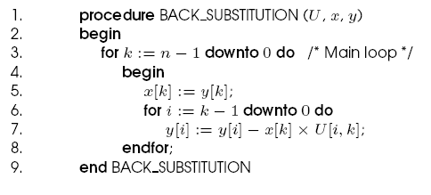
Solving a Triangular System:
Back-Substitution
The upper triangular matrix U undergoes back-substitution to determine the vector x.
A serial algorithm for back-substitution.

Slide 54
Solving a Triangular System:
Back-Substitution
The algorithm performs approximately n²/2 multiplications and subtractions.
Since complexity of this part is asymptotically lower, we should optimize the data distribution for the factorization part.
Consider a rowwise block 1-D mapping of the n x n matrix U with vector y distributed uniformly.
The value of the variable solved at a step can be pipelined back.
Each step of a pipelined implementation requires a constant amount of time for communication and Θ(n/p) time for computation.
The parallel run time of the entire algorithm is Θ(n²/p).

Slide 55


Solving a Triangular System:
Back-Substitution
If the matrix is partitioned by using 2-D partitioning on a logical mesh of processes, and the elements of the vector are distributed along one of the columns of the process mesh, then only the processes containing the vector perform any computation.
Using pipelining to communicate the appropriate elements of U to the process containing the corresponding elements of y for the substitution step (line 7), the algorithm can be executed in time.
While this is not cost optimal, since this does not dominate the overall computation, the cost optimality is determined by the factorization.

